Slide 1
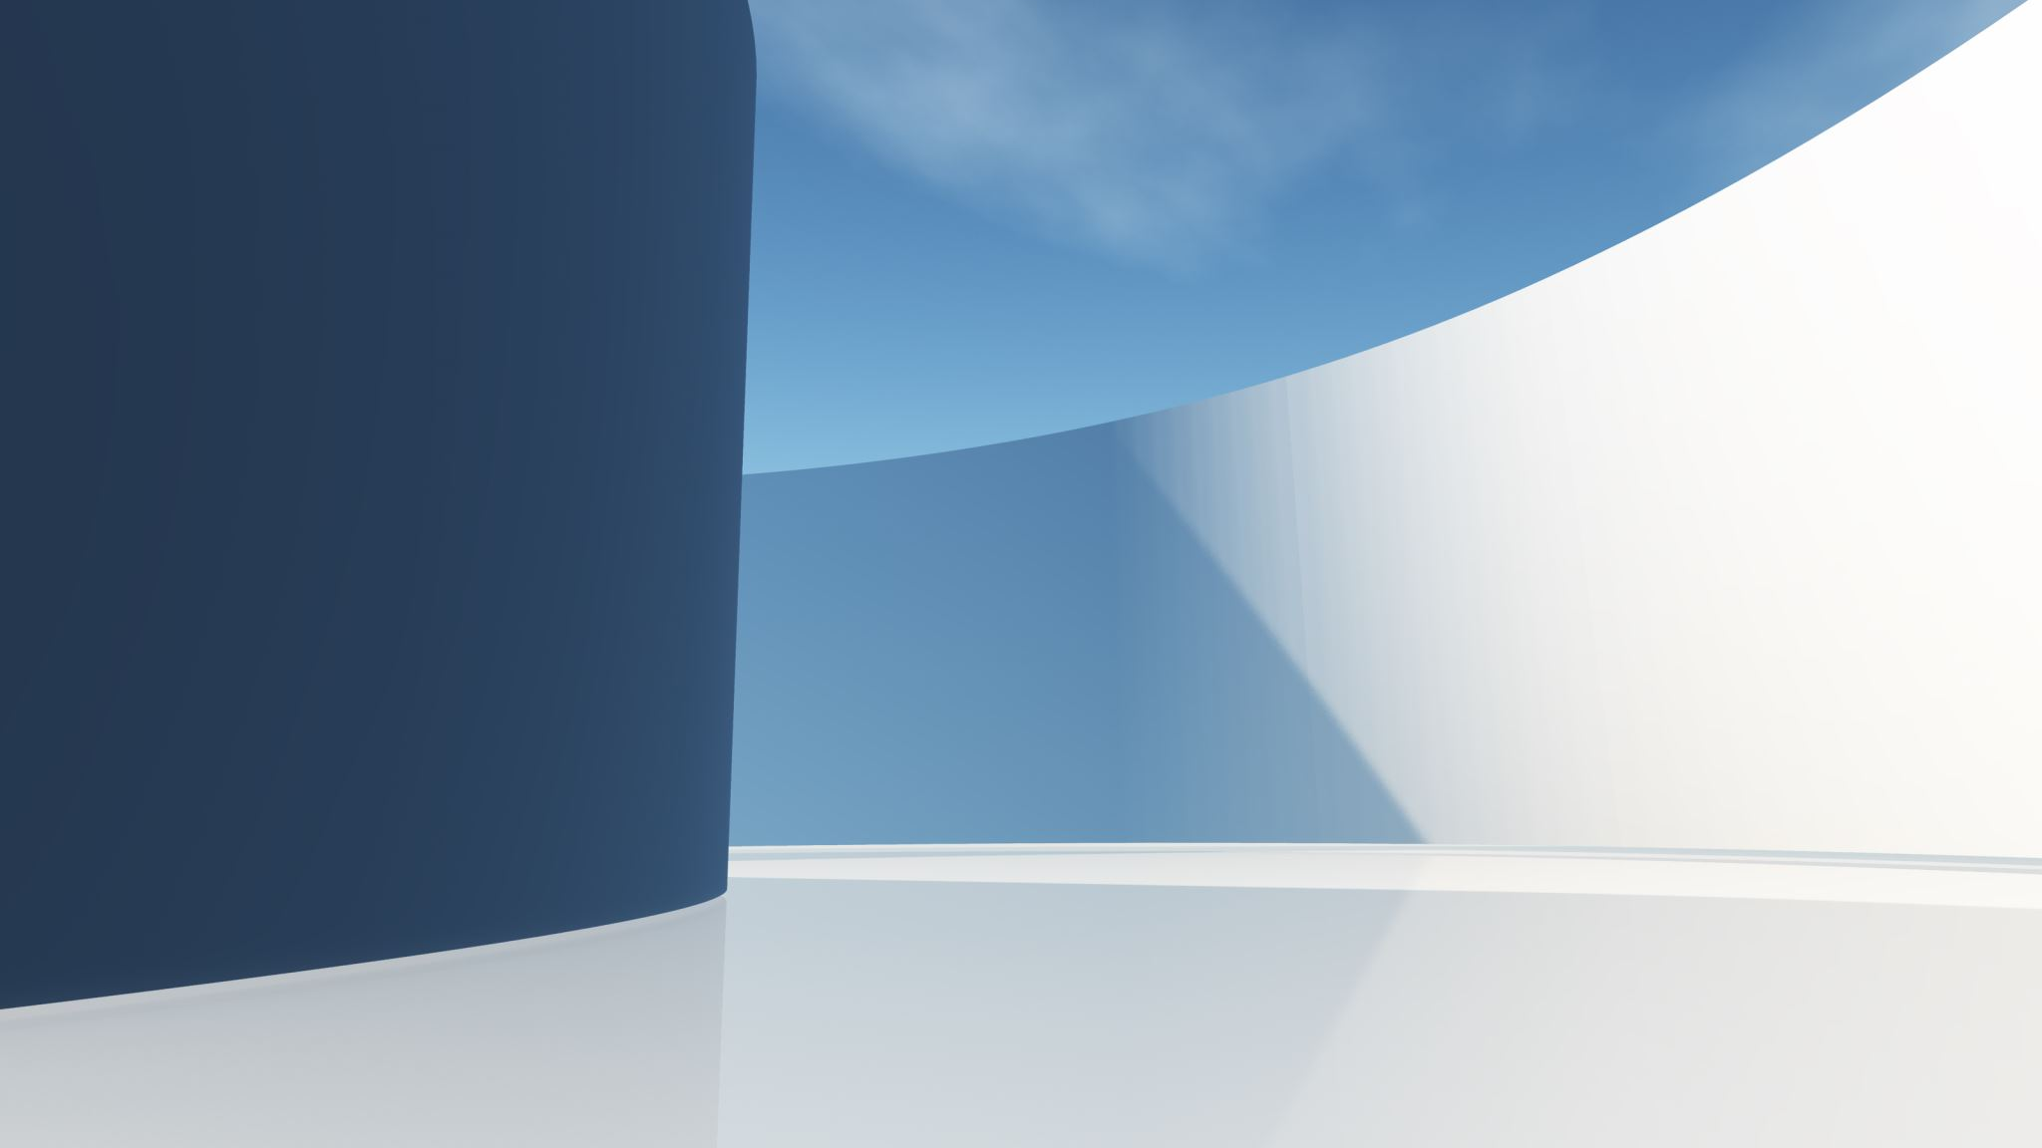

2024 Pacific Cup
STARTING AND COMMS
Michael Moradzadeh, Principal Race Officer

Slide 2
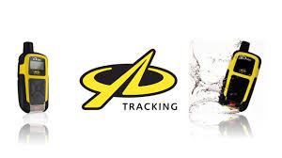
YB Tracker
DO NOT leave in the trunk (Needs to see sky)
Turn On
  Open bottom of jacket and slide it out
  To Turn the tracker on, press the LEFT ◄ and RIGHT ► keys together on the keypad The screen will light up and you will be prompted to 'press UP to start’.
Mount
  Clear view of sky (that’s where the satellites are)
  Not near another GPS antenna (>12” away) or under metal

Slide 3
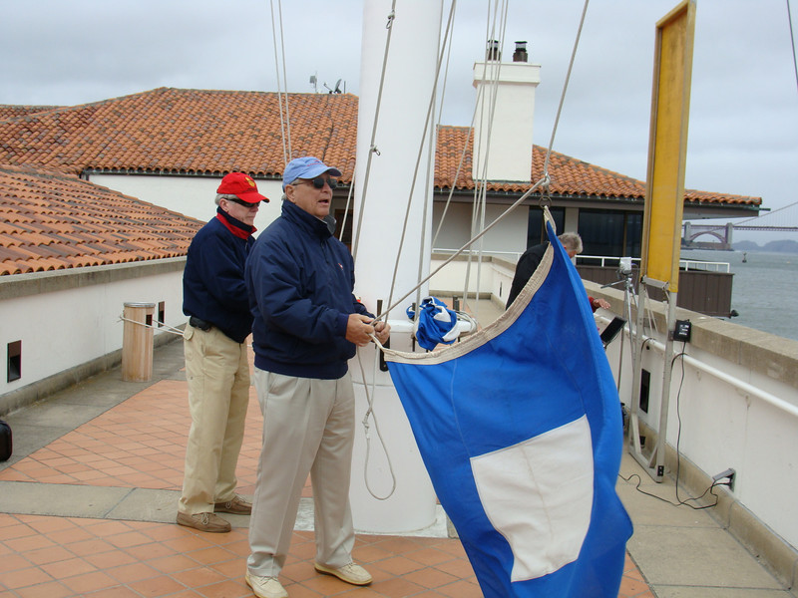
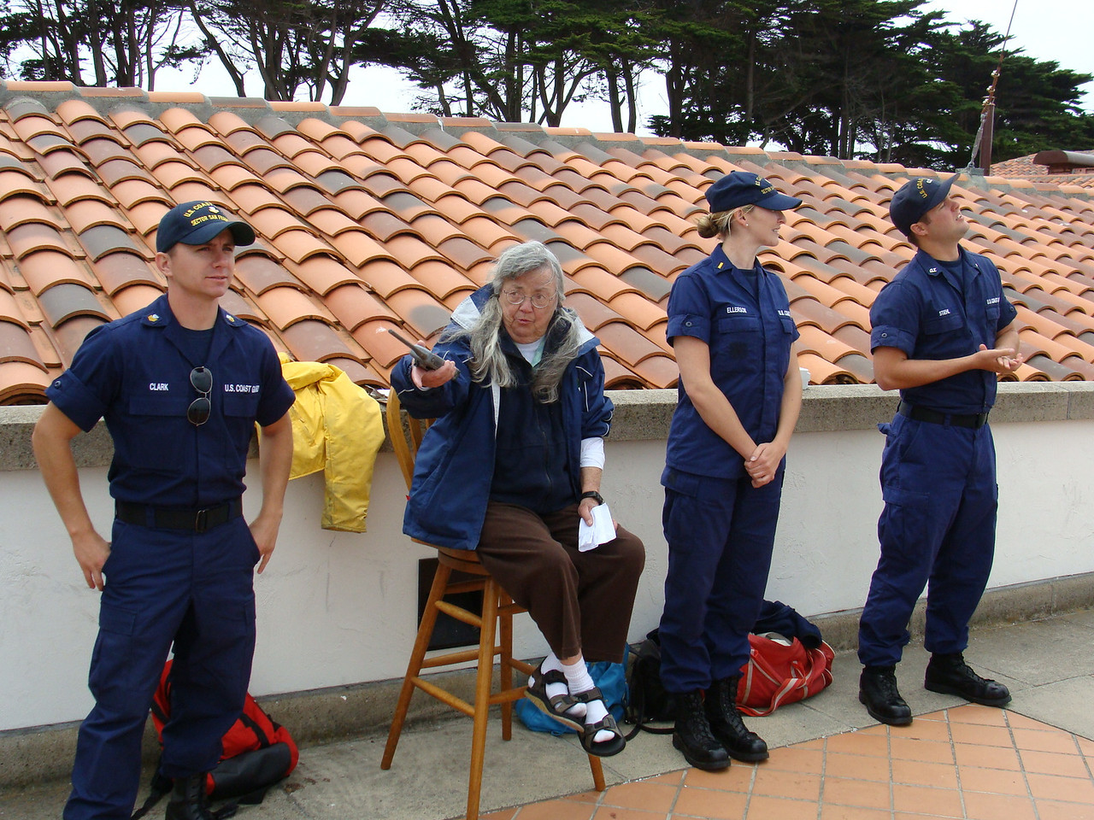
Starting The Race
Radio in – Must have eyes on the club. Answer questions
10 minute intervals. Using Class flags. Monitor Radio
It’s a long race, be cool
Anita Rock Warning

Slide 4
Weather Forecast
Light S'ly breezes expected from the California coast to 126W on the 15th.
Dense to patchy fog is likely along the California coast during the early morning and overnight hours on the 15th through 17th.
The winds will gradually veer and increase from 126W E'ward to 124W on the 16th, then will strengthen east of 125W with the strongest breezes along the California capes on the 17th through 18th.
Fresh to, at times, strong N-NE breezes north of 34N and west of 126W on the 15th will diminish to light N'ly breezes in this region on the 17th due to a building ridge reaching the region. The winds will back to more light W'ly breezes on the 18th.
South of 34N and west of 126W, moderate to, at times, fresh N-NE breezes on the 15th will diminish to light N-NE breezes overnight the 17th through 18th.

Slide 5
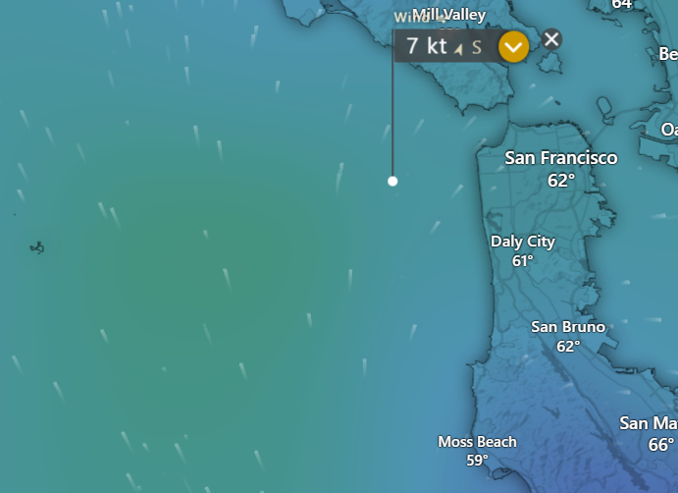
Special Considerations
Likely Light Air M & W
Watch out for shipping
Turn on AIS and Deploy Radar Reflector
Do not linger in shipping lanes

Slide 6










Flags

Slide 7
Underway
See your Communications Sheet
Daily Reports (penalty for failure)
Fleet Newsletter
Social Tags (@PACCUPRACE, #PACCUPRACE, #TFRTH)
Subscribe to Fleet Sheet
Subscribe to YB Tracker Reports
Your family can follow at pacificcup.org/follow

Slide 8
Fleet Newsletter!
Pearl
Last night was another night that kept us busy with squall after squall.
We were able to keep the kite up a bit longer this go around though
which was good. Still plugging away at the miles. Starting to dream of
beaches and beers.
Hang 20
No power. They won't read this. Let's make fun of them behind their
backs.
Total Eclipse
A2 exploded yesterday in a gust/wave/broach combo. Considering a craft
project for the crew making those colorful fabric leis out of the
remnants...
Perplexity
Feels like we finally transitioned into the final phase of downwind
surfing last night. Wind has been highly variable until now. Looking
forward to putting on some miles over the next few days.

Slide 9
If a bad thing happens
Please let us know, don’t be shy
  Send to pos@pcup.org or 415-BE-SALTY. Include “911” in the message to get faster attention
Contact Coast Guard, even if it’s to let them know of an “iffy” thing
Use EPIRB if needed
Rely on GW Medical for medical advice or emergencies

