Slide 1

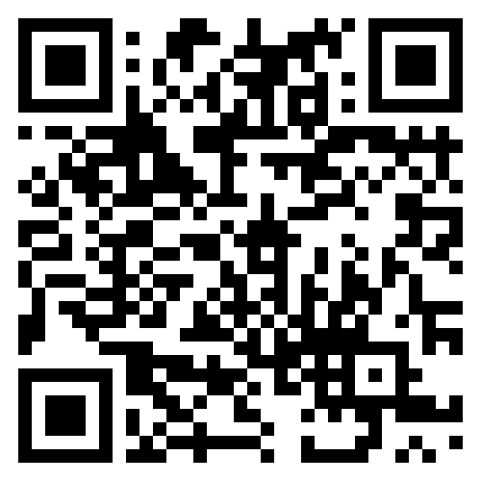
KANEOHE EVENTS –
Entertainment Schedule
Thursday – August 1, 2024 (Goslings Rum Party)
1600 – 1800 Happy Hour
1730 – 2000 Food Stations
1900 – 2200 – Go Ask Alice (Live Music - Classic Rock)
Friday – August 2, 2024 (Awards)
1600 – 1800 Happy Hour
1700 - 1900 Awards
1900 – 2130 Food Stations
1900 – 2200 Ferris Bueller Band (Live Music – 80s throwback cover band)
Monday – July 29, 2024
1600 – 1800 Happy Hour
1700 – 1930 Grill/Window Dinner
Tuesday - July 30, 2024 (Kanikapila Night)
1600 – 1800 Happy Hour
1700 – 1930 Grill/Window Dinner 1900 – 2100 Harry Koizumi (Live Music - Classic Hawaiian/slack key)
Wednesday – July 31, 2024 (Hawaiian Luau)
1600 – 1800 Happy Hour/Hawaiian activities
1830 – 2000 Food service
1845 – 1915 Live Hawaiian Music
1930 – 2130 Malu Productions Luau Show
Purchase tickets at https://admin.pacificcup.org/shop

Slide 2
Hawaiian Salt (Pa`akai)
Ti leaf (Kī)
Having Kī on board helps a boat find its way safely to the shores from which the ti leaves came from.
The intention of the pa`akai is to bless and protect your vessel and your crew on your journey.

Slide 3
IF YOU are hauling your boat at kyc you need to sign a waiver before you set sail. Waiver is on website in the race documents tab.
Waiver for Hoist

