Slide 1
Environment Afloat and at KYC
Galen Loving

Slide 2

Link: https://sailorsforthesea.org/programs-green-boating-guide/
Or just search online for “Green Boating Guide”

Slide 3
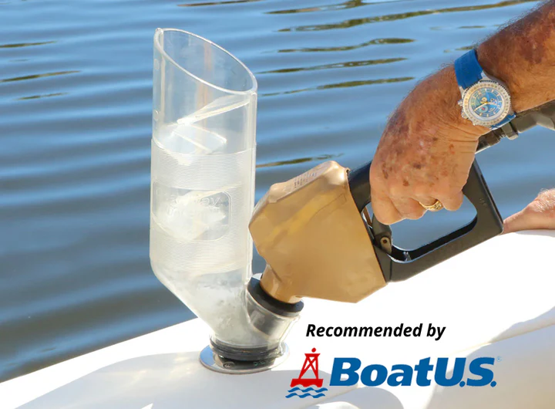
Fuel spill prevention
Leave sufficient head space in jerry cans for diesel to expand once in warmer latitudes.
Be sure to have oil absorbent bilge pads handy in case needed.
DO NOT DISPERSE SPILLS WITH DISH SOAP!
Have procedures in place to prevent spills if you’re planning to conduct fuel transfers at sea.
Clean Way Fuel Fill™ for safer transfers

Slide 4
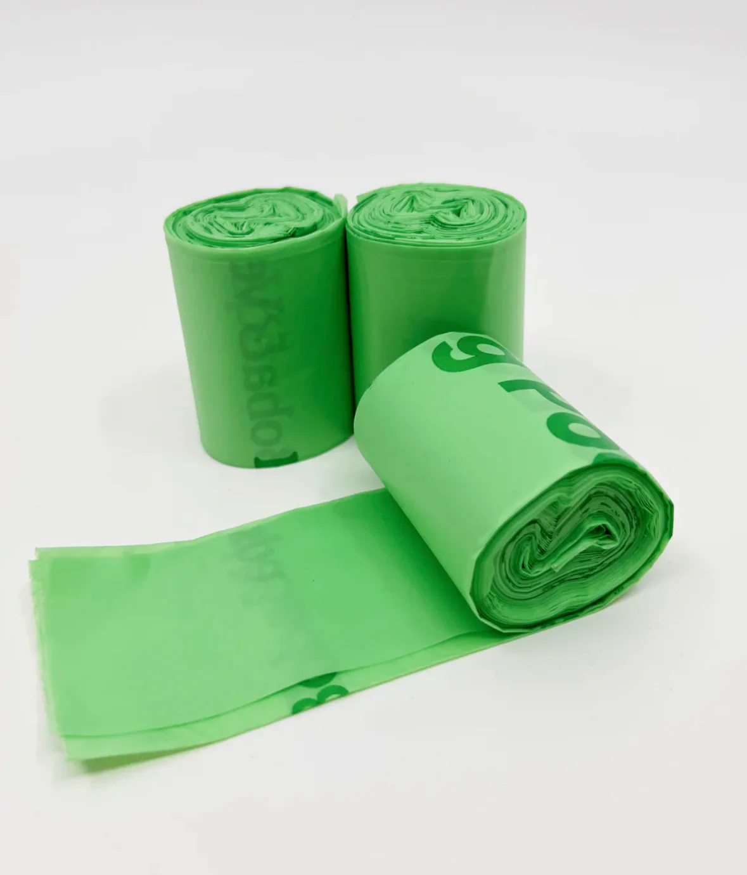
Waste management
Leave excess packaging at home.
No plastics overboard! Store waste onboard until you arrive in Hawaii. Recycle what you can.
Avoid single-use items.
Washable/reusable mess kits are preferred.
Poop bags must be paper.

Slide 5
Harmful chemicals
Choose environmentally friendly cleaning products for your boat.
  https://sailorsforthesea.org/boating-resources/non-toxic-cleaning-products/
Castile soaps like Dr Bronners are great for washing dishes.
Use reef safe sunscreens (no oxybenzone or octinoxate)

Slide 6
Respecting nature
Maintain legally required distances from protected marine mammals.
  100 yards minimum (Note - 500 yards for Northern Right Whales).
Avoid anchoring near reefs and protected marine habitats.

